Slide 1

Pub\Sub Messenger for Unity
https://supermax.github.io/pubsub
SuperMaxim.com

Slide 2
The Problem:
Wiring the Parts with Events – Tightly Coupled and may cause Memory Leak problems. The Publisher and the Subscriber have to know of each other, and a Subscriber can't be collected by the GC if it's connected with the Publisher with strong event reference.
Using Unity Event Routing – Although Unity Event Routing is a very good feature, it is a Unity Specific Solution and we need a generic one. Also, we cannot use it everywhere even if the project is in Unity.
Bad OPP and Less Encapsulated Objects - In commonly used C# events or delegates classes “familiar” with each other and this prevents good modularity.

Slide 3
The Problem:
Example of common usages of events in C#:
public class ClassA
{
// event that passes instance of ClassA when it is invoked
public event Action<ClassA> EventA;
// static event that passes instance of ClassA when it is invoked
public static event Action<ClassA> EventB;
}
public class ClassB
{
// event handler - method that is invoked by event and receives objA instance
public void OnEventA(ClassA objA) { }
}
ObjA
EventA
ObjB
public class ClassC
{
private ClassA _objA;
private ClassB _objB;
private ClassB _objC;
public void RegisterEvents()
{
// _objB.OnEventA is attached to _objA.EventA and _objB is now referenced by _objA
// _objB will not be removed from memory until it's handler OnEventA will be detached from EventA
// or until objA will be removed from memory
_objA.EventA += _objB.OnEventA;
// _objC.OnEventA is attached to ClassA.EventB and _objC is not referenced by static pointer in ClassA
// _objC will not be removed from memory until it's handler OnEventA will be detached from static EventB
// static references are worse case of memory leaks
ClassA.EventB += _objC.OnEventA;
}
}
ClassA
EventB
ObjC

Slide 4
The Solution:
Custom Pub\Sub Messenger - Container for Events that allows Decoupling of Publishers and Subscribers so they can evolve independently. This Decoupling is useful in Modularized Applications because new modules can be added that respond to events defined by the Shell or, more likely, other modules. All events have a Weak Reference and invocation can be done Async or Sync way.
Instead of passing objects or modules, pass small Payloads (Data/Messages) that are relevant for the specific cases/events.
Classes/Modules will not be “familiar” with each other = better encapsulation and less dependencies.
In case of subscriber’s destruction, it will be removed automatically from Messenger’s list, since it is via Weak Reference.
Pub/Sub can be great pattern in combination with Dependency Injection and with Inversion of Control (all three belong to SOLID).

Slide 5
The Solution:
Usage of Messenger as Pub/Sub mechanism:
public class ClassA
{
public void PublishEvent()
{
// publish new payload with specific data
Messenger.Default.Publish(new PayloadA { Id = 123, Name = “ABC” });
}
}
public class PayloadA
{
public int Id { get; set; }
public string Name { get; set; }
}
public class ClassB
{
// event handler - method that is invoked by Messenger and receives payload instance
public void OnEventA(PayloadA payload) { }
}
ObjA
public class ClassC
{
private ClassA _objA;
private ClassB _objB;
private ClassB _objC;
public void RegisterEvents()
{
// subscribe handler _objB.OnEventA to PayloadA
Messenger.Default.Subscribe<PayloadA>(_objB.OnEventA);
// subscribe handler _objC.OnEventA to PayloadA with filter
Messenger.Default.Subscribe<PayloadA>(_objC.OnEventA, PayloadAFilter);
}
private bool PayloadAFilter(PayloadA payload) { /*TODO*/ }
}
PayloadA
Messenger
PayloadA
ObjB
PayloadA
WeakRef
+ Encapsulation
ObjC

Slide 6
Event Routing by Pub\Sub Messenger
Publisher
Event Messenger
Subscriber 2
Subscriber 1
Filtered Subscription
Subscriber 3

Slide 7
Use Cases for Pub\Sub Messenger:
Pass Payload between disconnected/independent parts of code;
Thread Safe Invocation of Events between disconnected/independent parts of code;
Asynchronous Invocation of Events between disconnected/independent parts of code;
Filtered Invocation of Events between disconnected/independent parts of code;
Obfuscated Invocation of Events between disconnected/independent parts of code;

Slide 8
Messenger API:
Messenger
Implements this interface:
/// <summary>
/// Interface for Pub/Sub Messenger
/// </summary>
public interface IMessenger
{
/// <summary>
/// Publish given payload to relevant subscribers
/// </summary>
/// <param name="payload">Instance of payload to publish</param>
/// <typeparam name="T">The type of payload to publish</typeparam>
void Publish<T>(T payload);
/// <summary>
/// Subscribe given callback to receive payload
/// </summary>
/// <param name="callback">The callback that will receive the payload</param>
/// <param name="predicate">The predicate to filter irrelevant payloads (optional)</param>
/// <typeparam name="T">The type of payload to receive</typeparam>
void Subscribe<T>(Action<T> callback, Predicate<T> predicate = null);
/// <summary>
/// Unsubscribe given callback from receiving payload
/// </summary>
/// <param name="callback">The callback that subscribed to receive payload</param>
/// <typeparam name="T">Type of payload to unsubscribe from</typeparam>
void Unsubscribe<T>(Action<T> callback);
}

Slide 9
Messenger API:
Messenger
Access to default Messenger instance via: Messenger.Default
Publish
Messenger.Default.Publish<Payload>(new Payload{ /* payload params */ });
Payload – the payload that will be published to subscribers of this type

Slide 10
Messenger API:
Subscribe
Messenger.Default.Subscribe<Payload>(Callback);
Payload – the type of Callback parameter
Callback – delegate (Method) that will receive payload
private static void Callback(Payload payload)
{
// Callback logic
}
Subscribe with Predicate
Messenger.Default.Subscribe<Payload>(Callback, Predicate);
Predicate – delegate (Function) that will receive payload to filter
private static bool Predicate(Payload payload)
{
// Predicate filter logic
// if function will return ‘false’ value, the Callback will not be invoked
return accepted;
}

Slide 11
Messenger API:
Subscribe
Messenger.Default.Unsubscribe<Payload>(Callback);
Payload – the type of Callback parameter
Callback – delegate (Method) that will be removed from subscribers

Slide 12
Tips for Correct Usage:
DON’T use Messenger if you have quick access to shared code parts to invoke events/methods in same module/class;
ALWAYS ensure that you unsubscribe when you’re done with consuming of shared payloads;
DON’T publish events in endless loop;
PREFER using Filtered subscriptions;

Slide 13
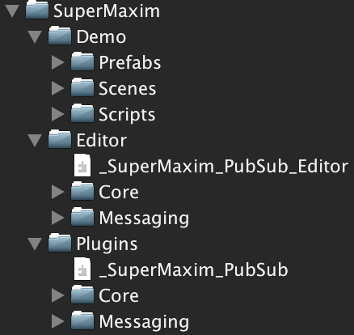
Package Structure:
Folders
Demo (sample) files
Editor scripts
Runtime scripts
Folders:
Core – base classes and scripts that are not specific for Messenger
Messaging – classes and scripts that are specific for Messenger

Slide 14
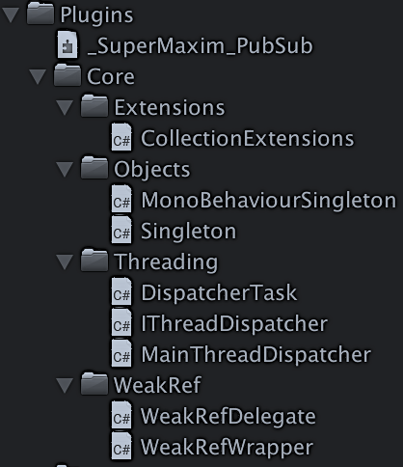
Package Structure:
Plugins / Core
Folder | File/Class/Script | Description
Extensions | CollectionExtensions | Static class with collection extension functions
Objects | MonoBehaviourSingleton | Abstract base class for MB singletons
Objects | Singleton | Abstract base class for classic singletons
Threading | DispatcherTask | Task unit with weak ref. (pointer) to delegate to execute on main thread
Threading | IThreadDispatcher | Interface for Thread Dispatcher API
Threading | MainThreadDispatcher | Singleton class that implements IThreadDispatcher and provides API to sync tasks between main thread and other threads
WeakRef | WeakRefDelegate | Weak reference for delegate (inherits from WeakRefWrapper)
WeakRef | WeakRefWrapper | Weak reference wrapper (disposable)
Folders:
Extensions – extensions classes
Objects – core base classes
Threading – multithreading related classes/scripts
WeakRef – weak reference handling classes

Slide 15
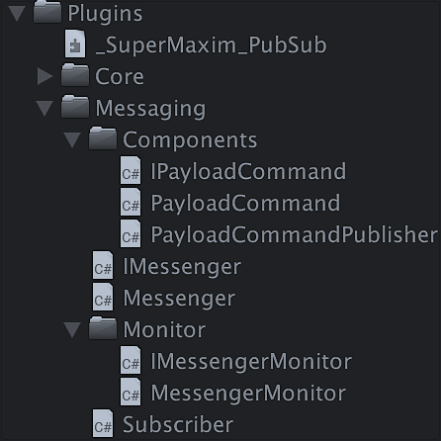
Package Structure:
Plugins / Messaging
Folder | File/Class/Script | Description
Messaging / Components | IPayloadCommand | Interface for Payload Command – a generic payload with Id and Dic. of string key value pair Data
Messaging / Components | PayloadCommand | Implementation of generic Payload Command, implementing IPayloadCommand interface
Messaging / Components | PayloadCommandPublisher | MB Script with Publish method that publishes a generic PayloadCommand – can be used with UGUI events or other ways
Messaging | IMessenger | Interface for Messenger API
Messaging | Messenger | Implementation of IMessenger interface with Pub-Sub logic; contains container of subscribers; singleton that is accessible via Messenger.Default
Messaging | Subscriber | Represents single item for subscribers’ container. Including weak ref. pointing to callback method and weak ref. pointing to predicate.
Messaging / Monitor | IMessengerMonitor | Interface for MessengerMonitor API
Messaging / Monitor | MessengerMonitor | Debugging and monitoring tool for Messenger
Folders:
Components – useful unity components
Monitor – debugging and monitoring tools

Slide 16
DEMO – Game Chat:
Goals:
Show basic usage of Messenger;
Use real world example – Chat between players;
Include examples of message filtering and multithreading;
Show “Best Practices” approach in implementation;

Slide 17
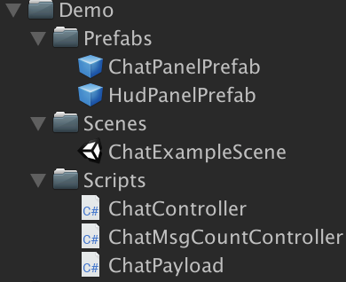
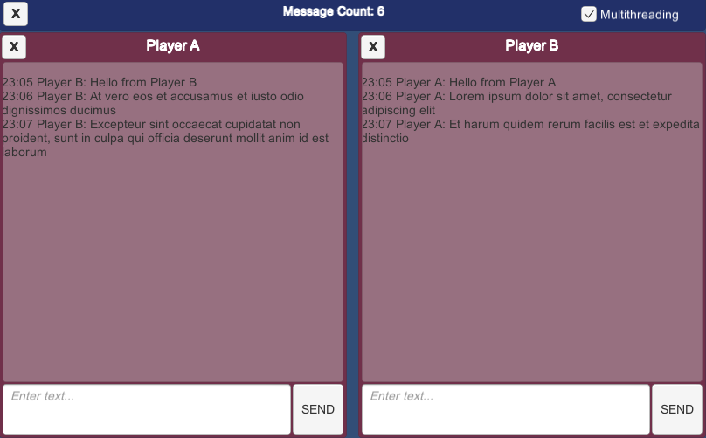
Demo Structure:
Demo
Folder | File/Class/Script | Description
Prefabs | ChatPanelPrefab | Prefab that contains all elements for player chat UI (see prefab in editor)
Prefabs | HubPanelPrefab | Prefab that contains top HUD elements (see prefab in editor)
Scenes | ChatExampleScene | Example scene with chat UI (see scene in editor)
Scripts | ChatController | Script that controls ChatPanelPrefab (message input, publish and subscribe)
Scripts | ChatMsgCountController | Scripts that ‘listens’ to chat messages, counts them and displays count in HUD
Scripts | ChatPayload | Payload class that is used to pass messages between chat panels
HudPanelPrefab
ChatPanelPrefab

Slide 18
Chat Controller:
Implements this basic interface:
TBD

Slide 19
Unit Tests:
Coverage:
…;
…;
…;
…;

